Slide 1
base_baseline
Pipeline: Baseline
Vessel Pathway: Base
Port Pathway: Base

Slide 2
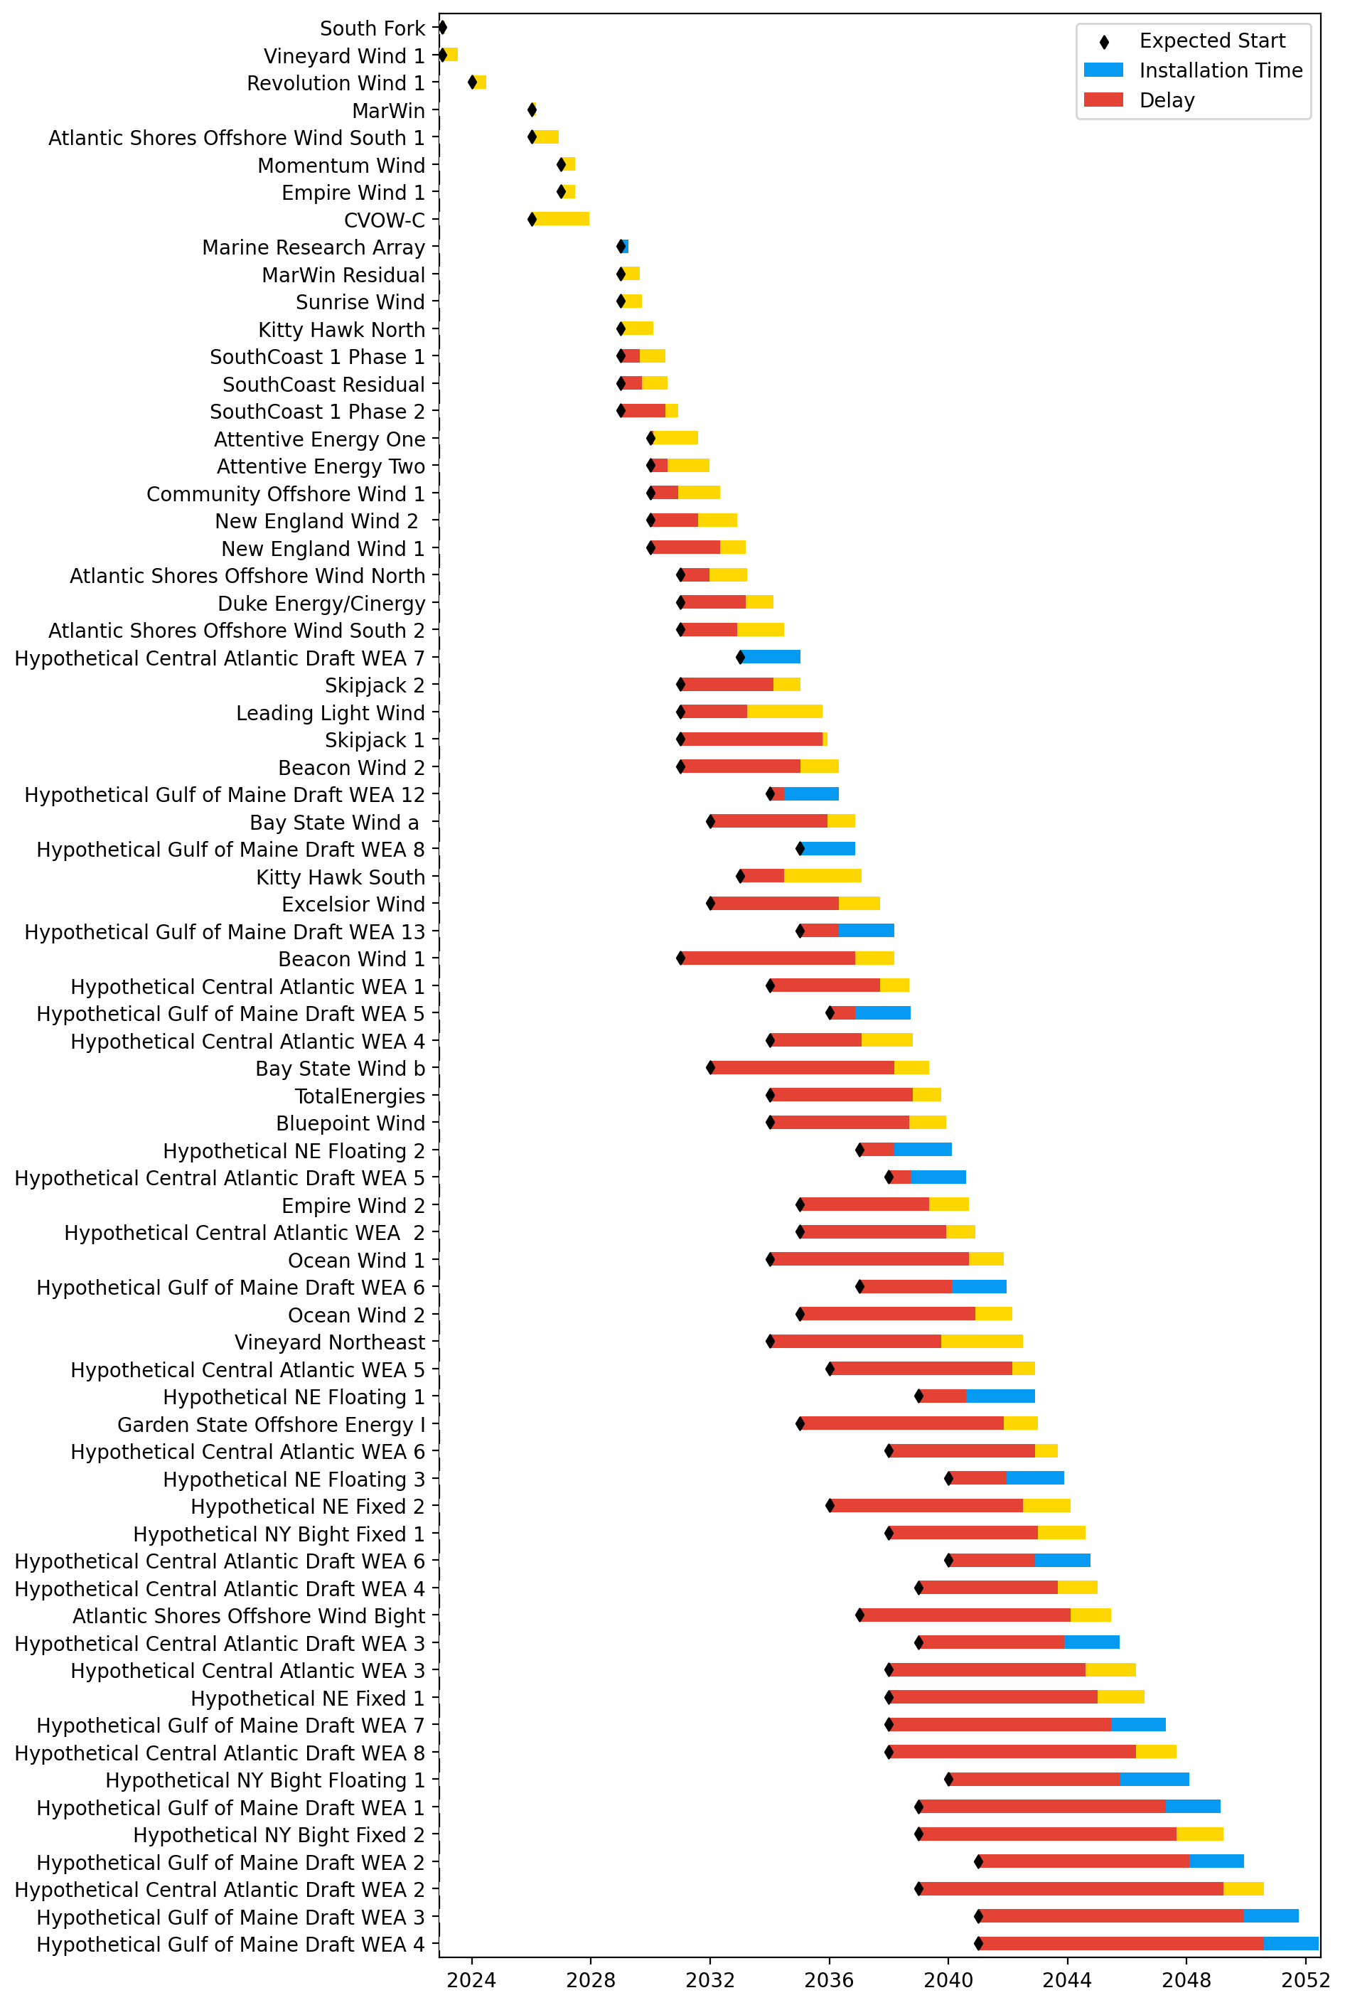
Full Gantt

Slide 3
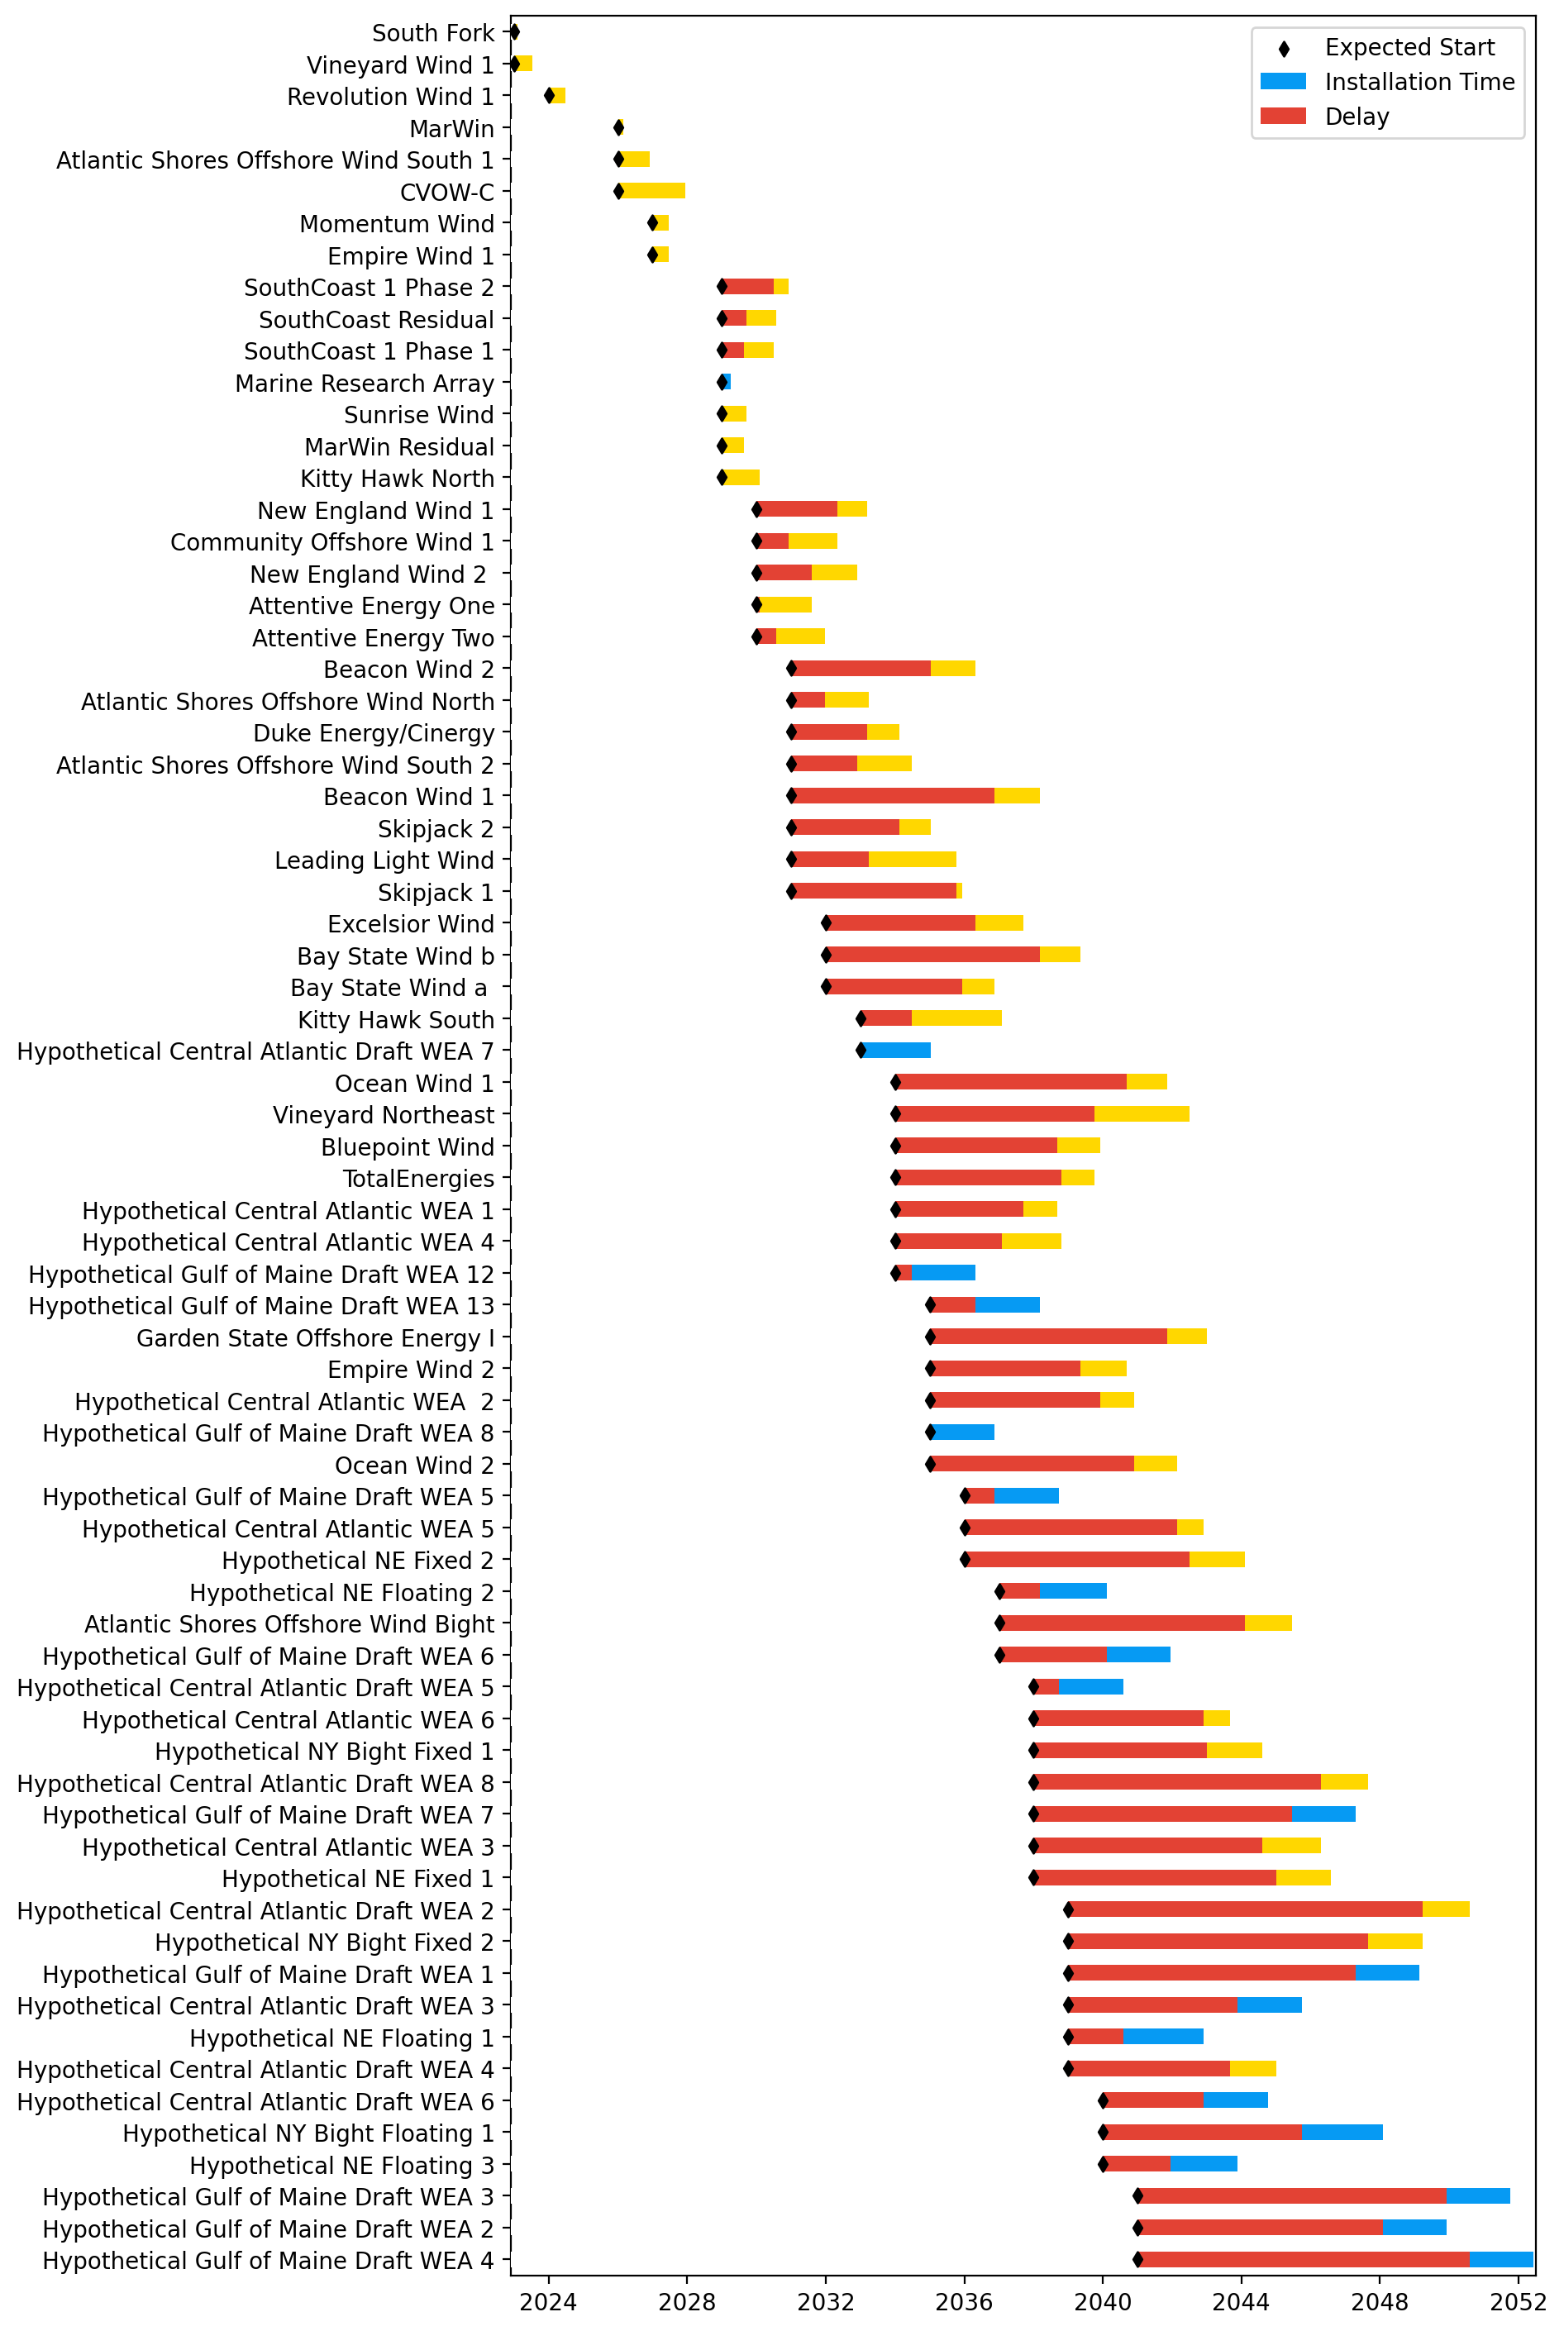
Sorted Full Gantt

Slide 4
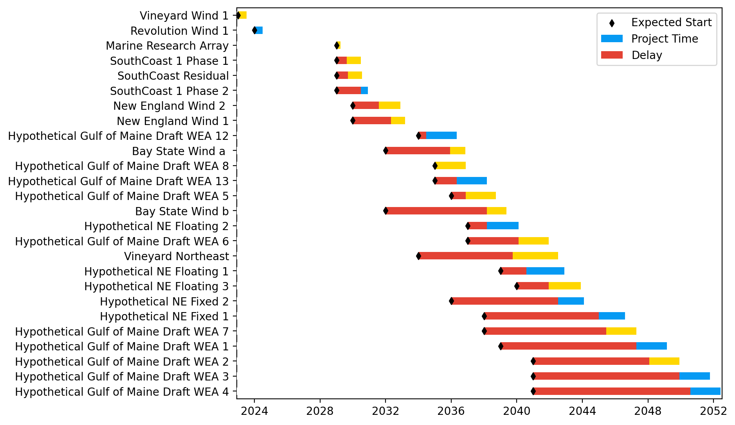
New England Gantt

Slide 5
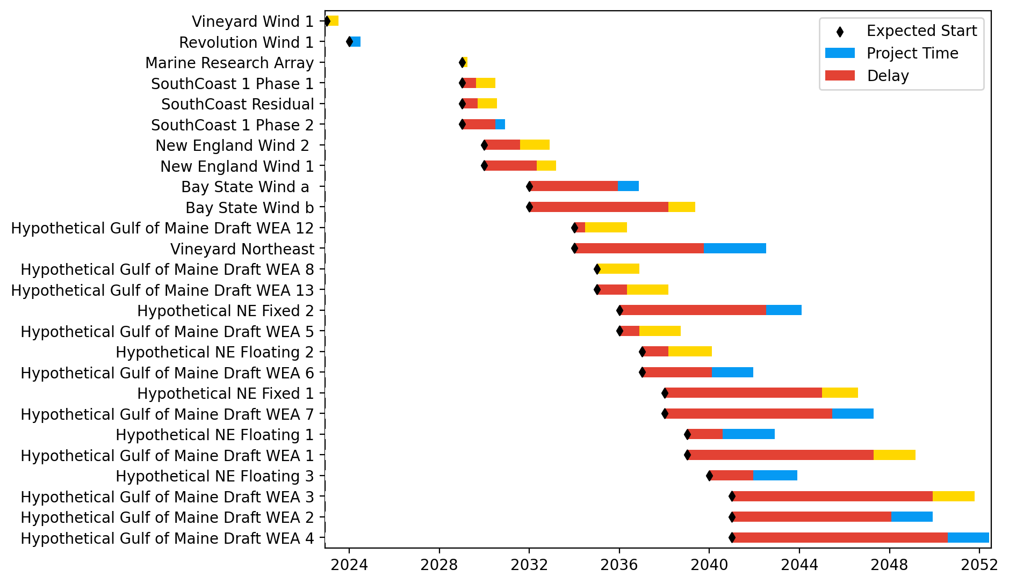
Sorted New England Gantt

Slide 6
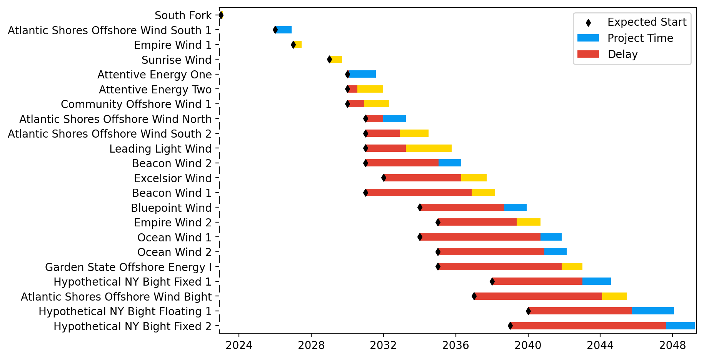
New York/New Jersey Gantt

Slide 7
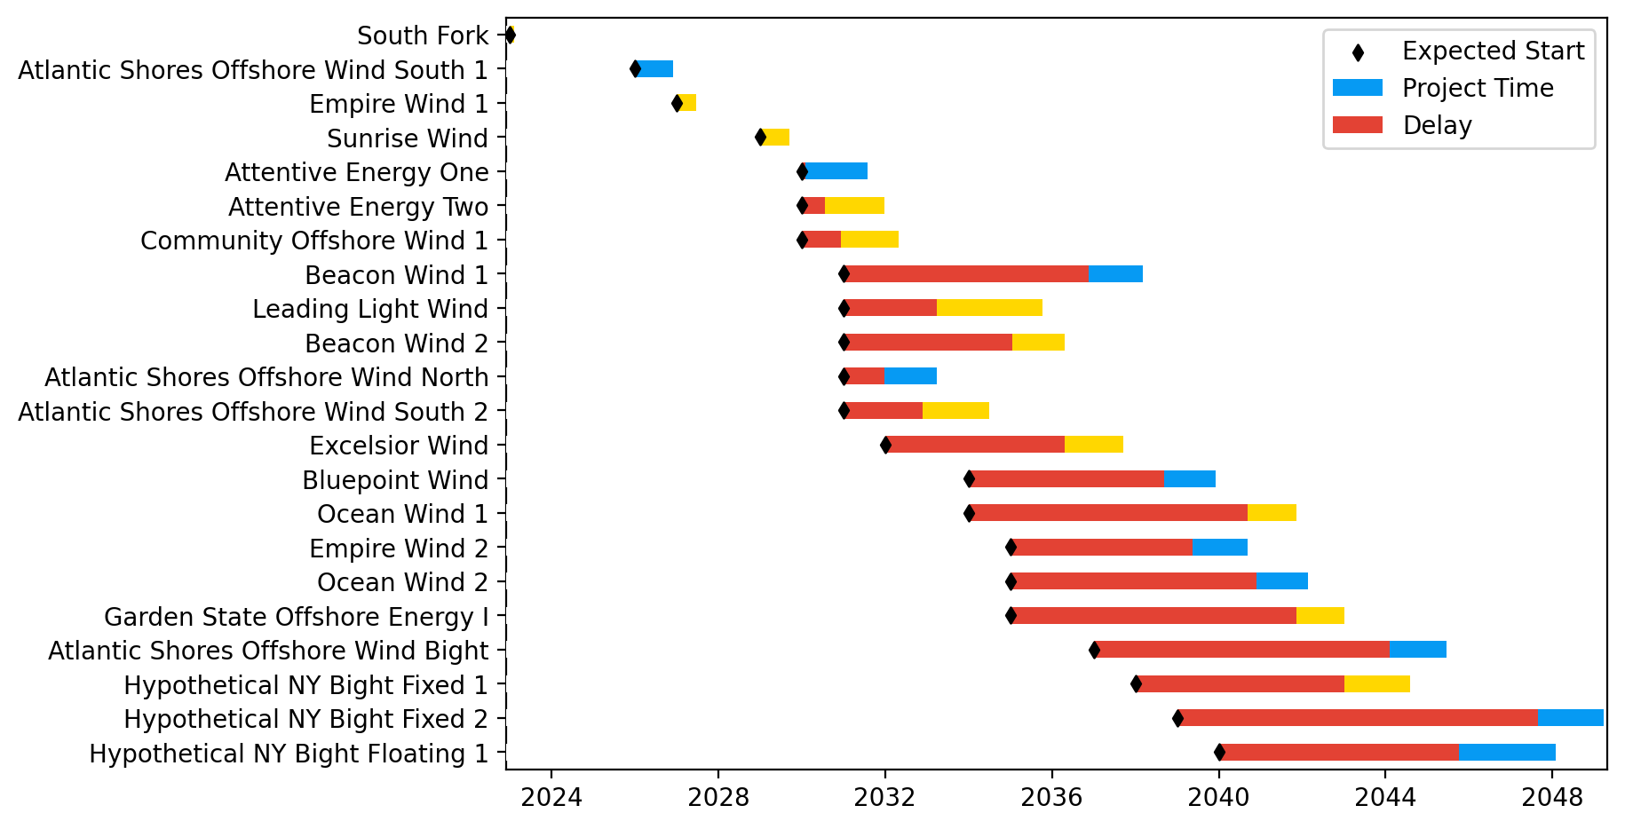
Sorted New York/New Jersey Gantt

Slide 8
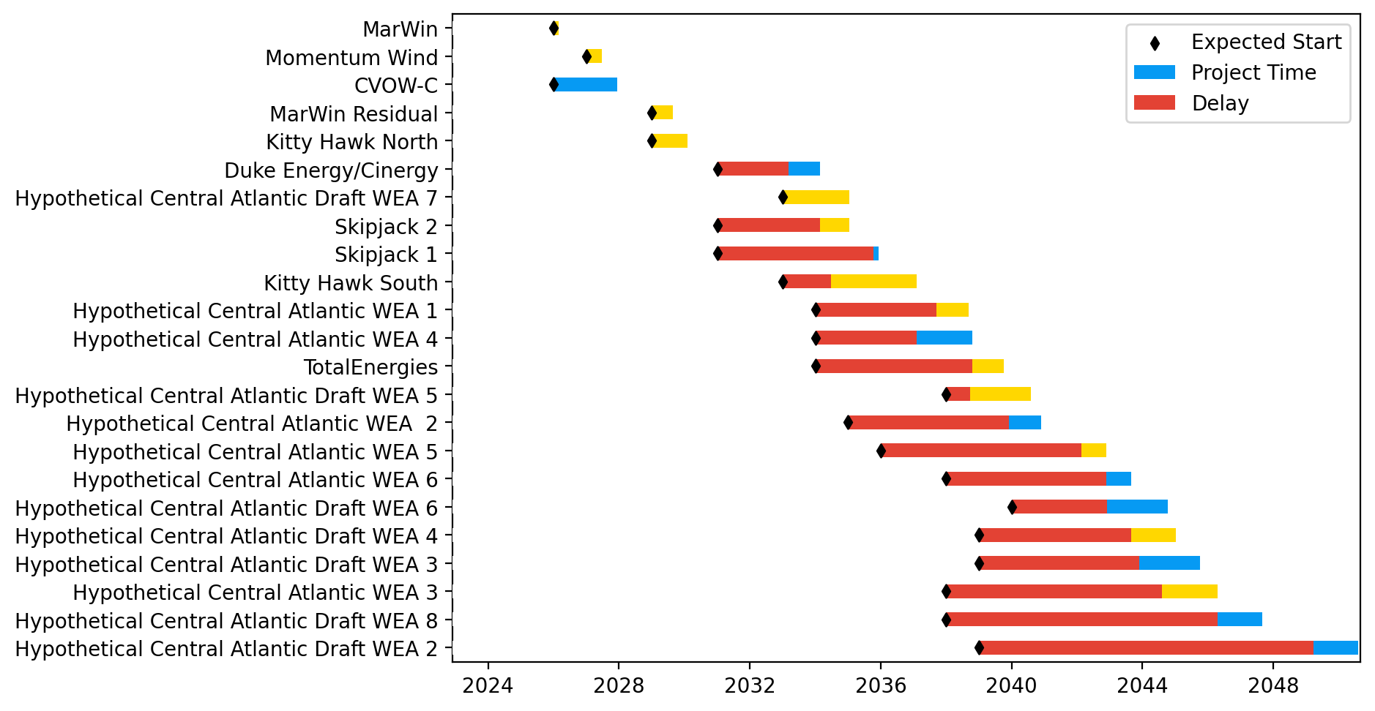
Midatlantic Gantt

Slide 9
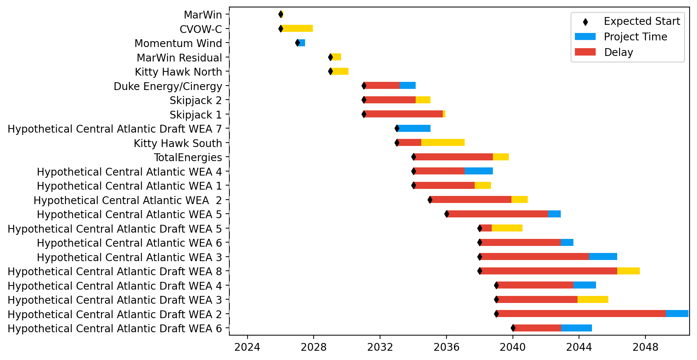
Sorted Midatlantic Gantt

Slide 10
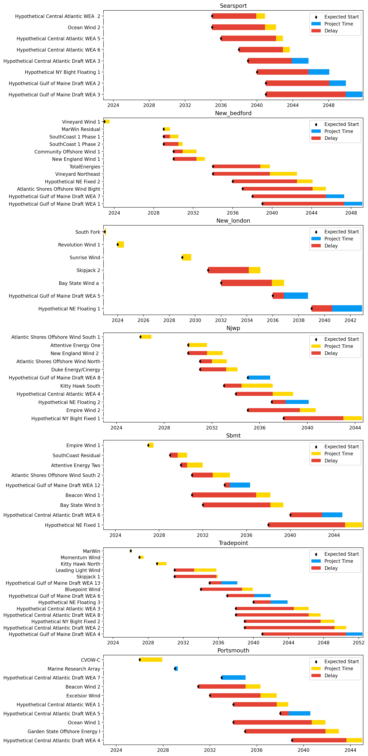
Port Gantts

Slide 11
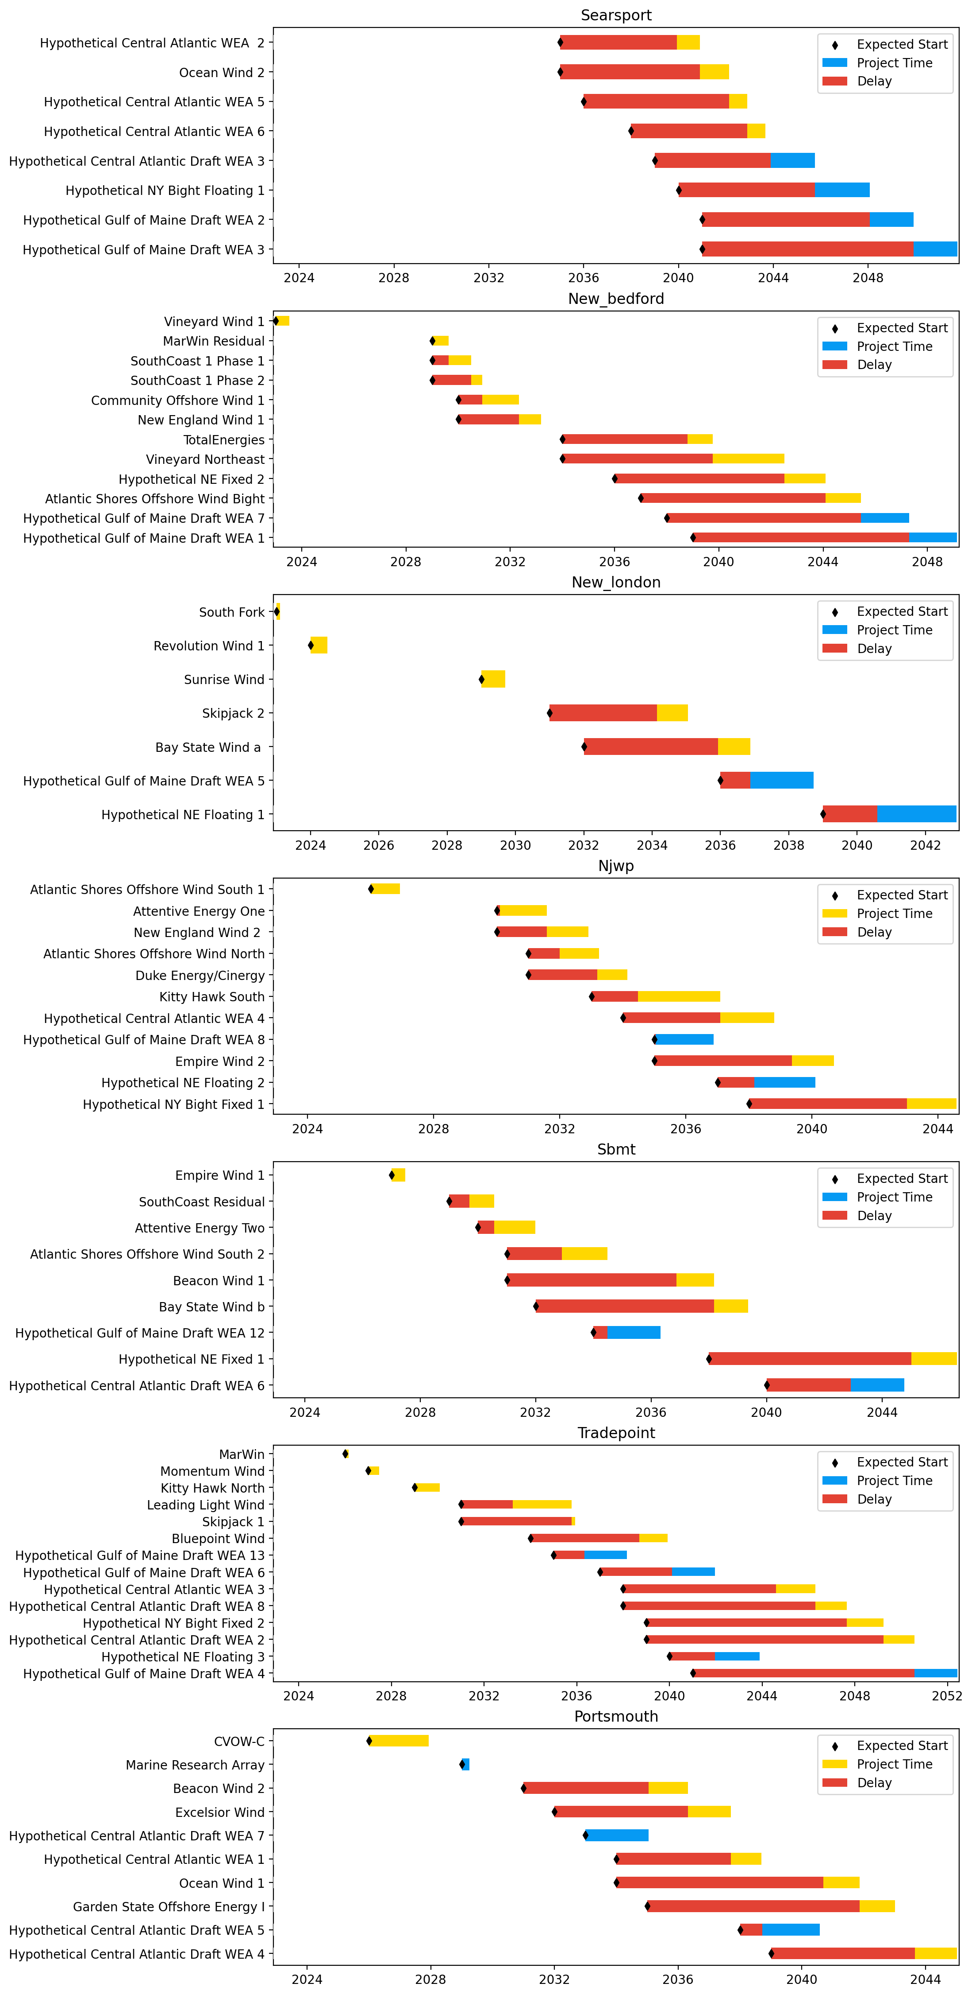
Sorted Port Gantts

Slide 12
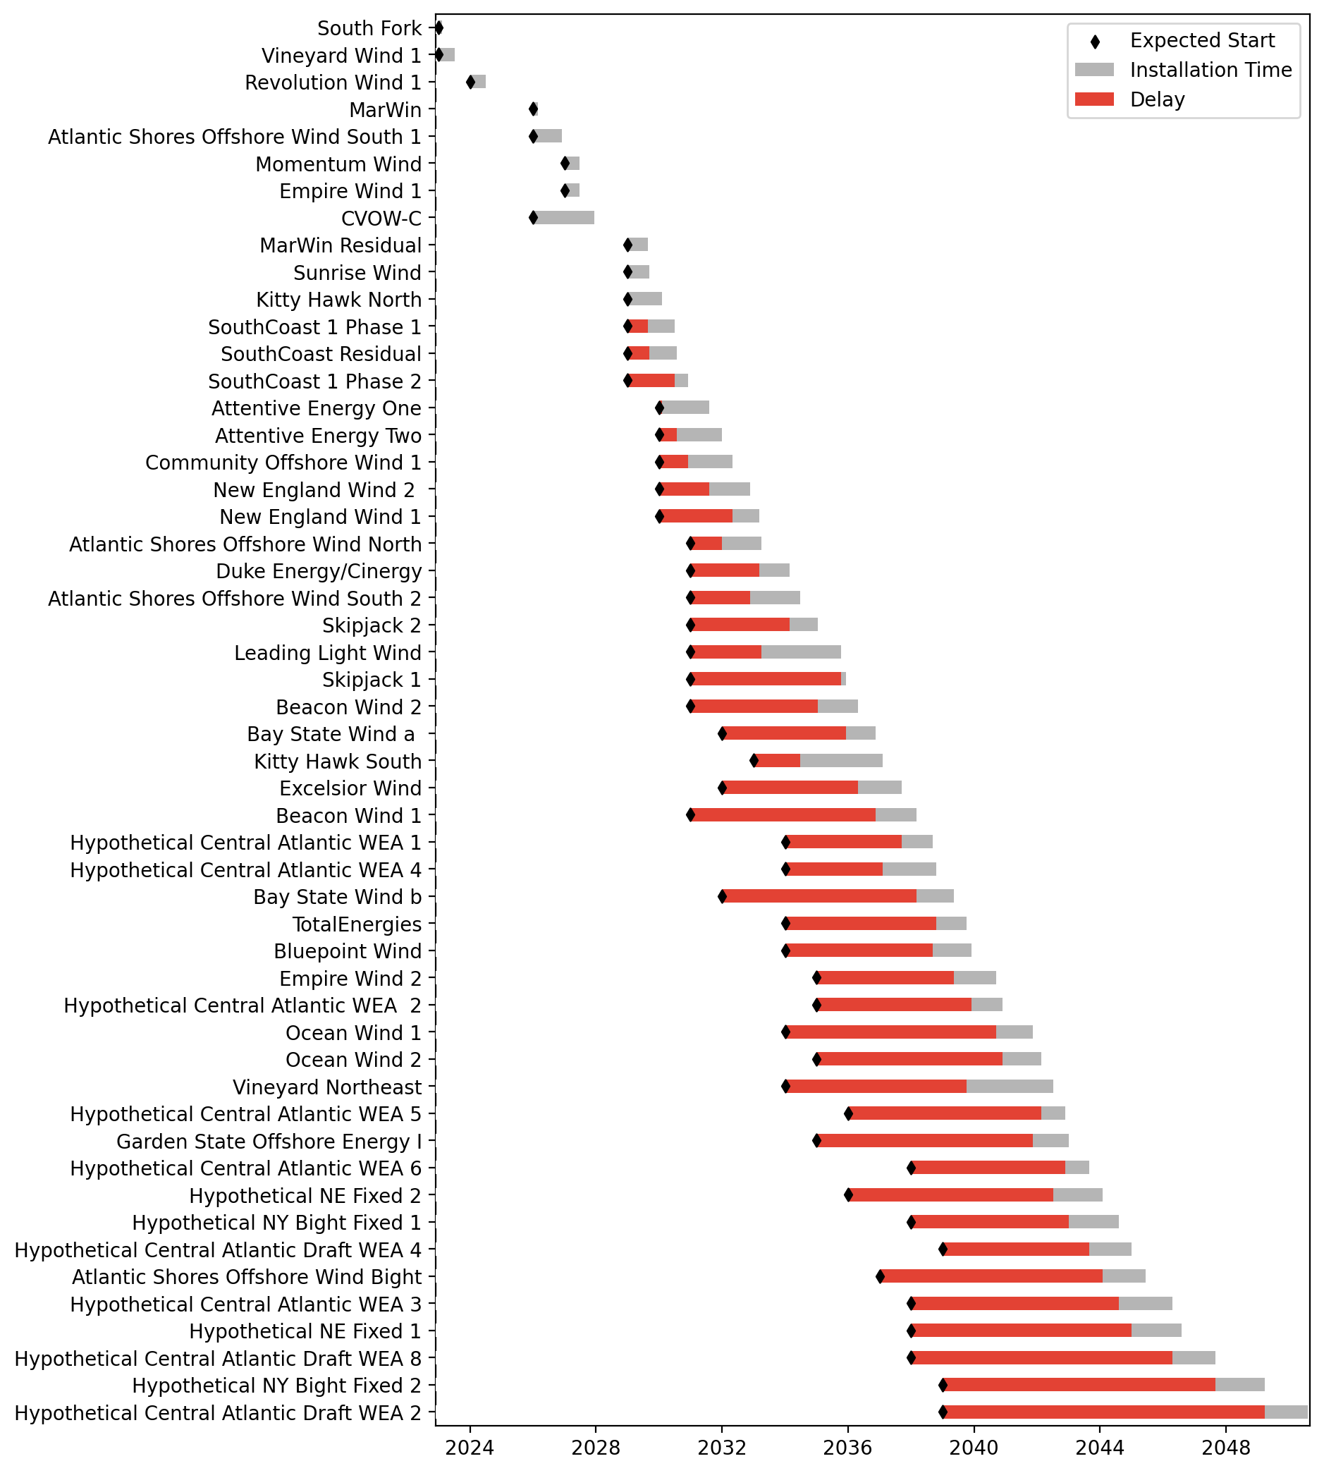
Fixed Gantt

Slide 13
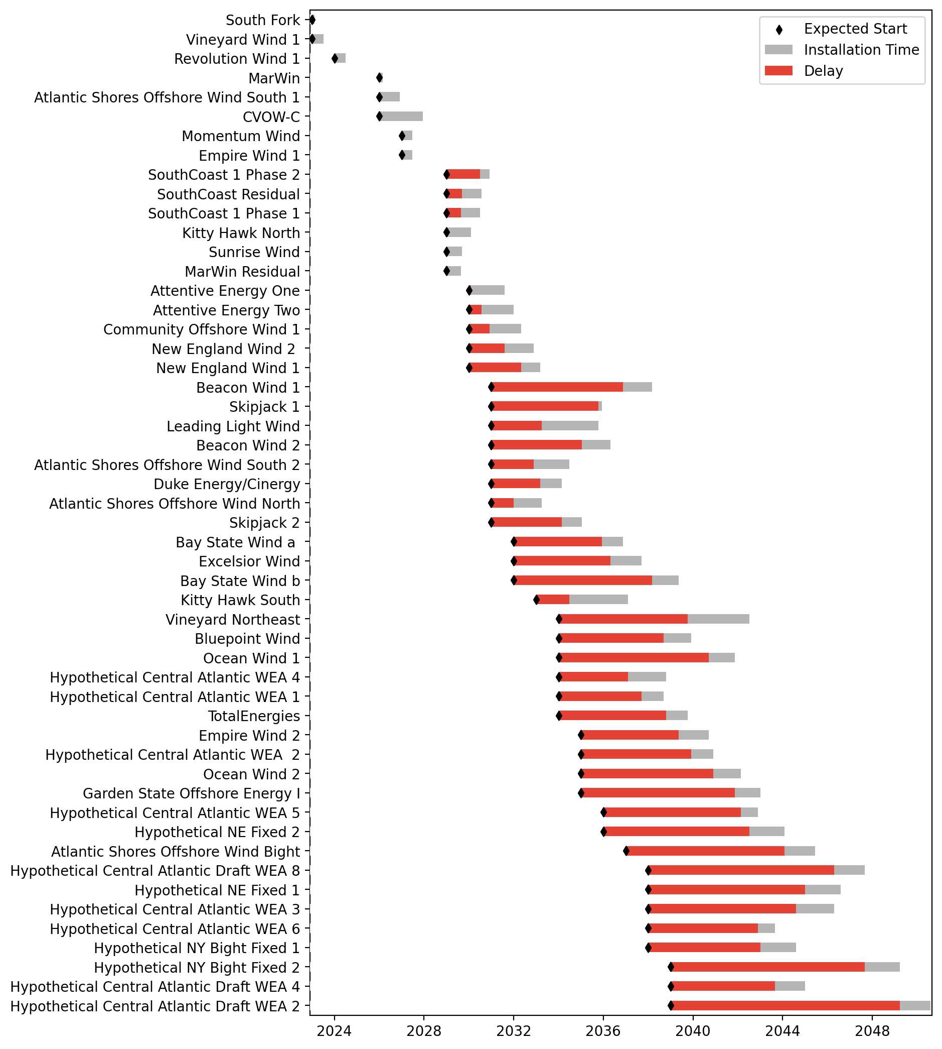
Sorted Fixed Gantt

Slide 14
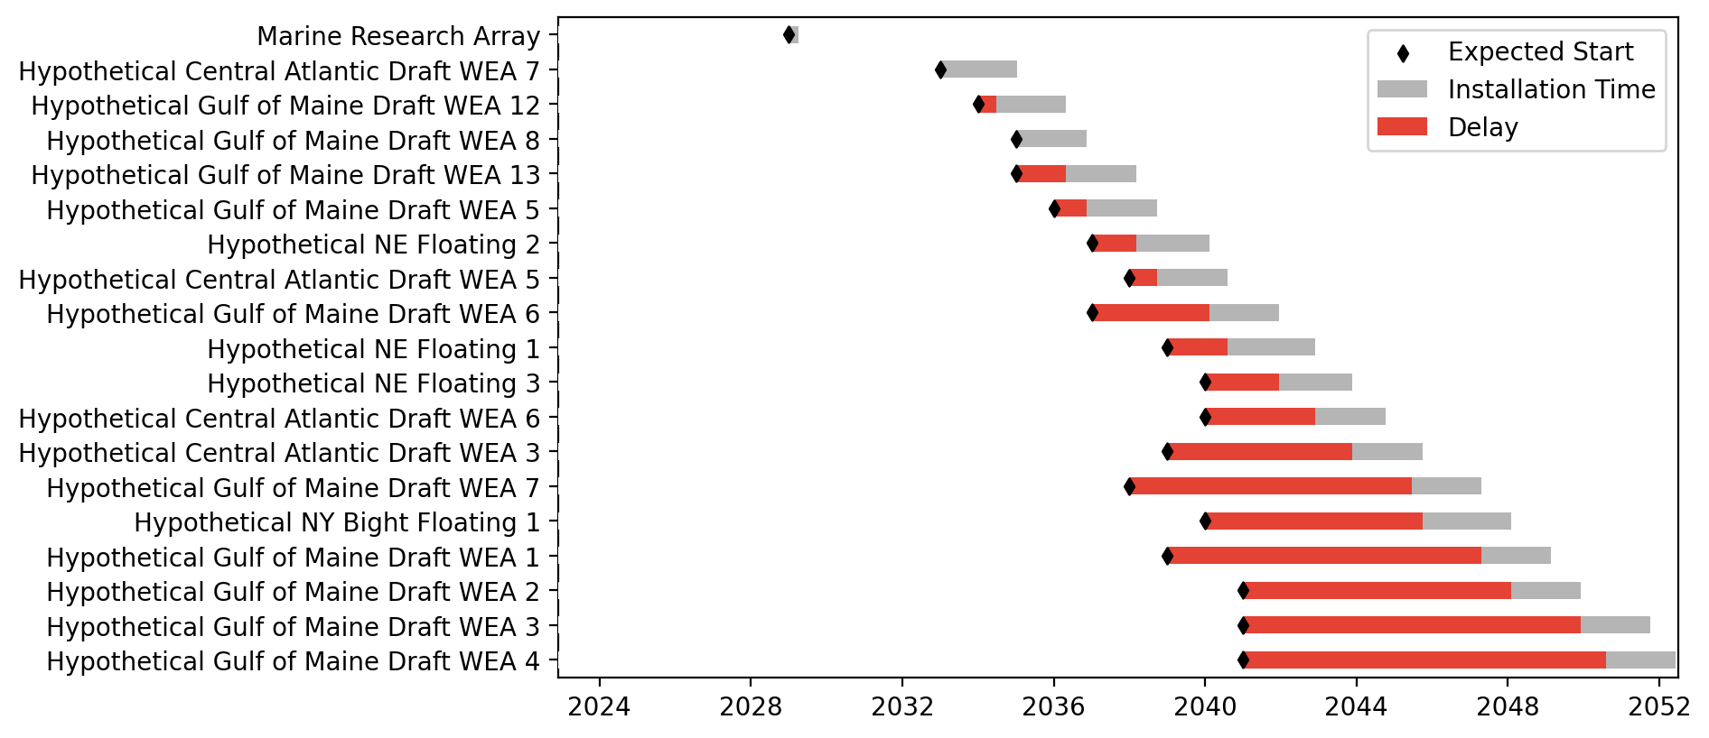
Floating Gantt

Slide 15
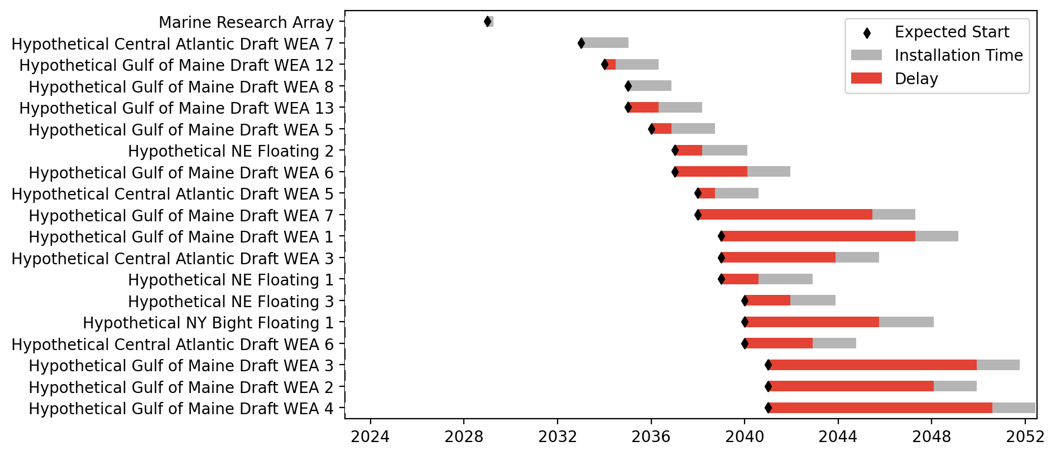
Sorted Floating Gantt

Slide 16
base_baseline_dist
Pipeline: Baseline - High Dist
Vessel Pathway: Base
Port Pathway: Base

Slide 17

Full Gantt

Slide 18

Sorted Full Gantt

Slide 19
New England Gantt

Slide 20
Sorted New England Gantt

Slide 21

New York/New Jersey Gantt

Slide 22

Sorted New York/New Jersey Gantt

Slide 23
Midatlantic Gantt

Slide 24
Sorted Midatlantic Gantt

Slide 25

Port Gantts

Slide 26

Sorted Port Gantts

Slide 27

Fixed Gantt

Slide 28

Sorted Fixed Gantt

Slide 29
Floating Gantt

Slide 30
Sorted Floating Gantt

Slide 31
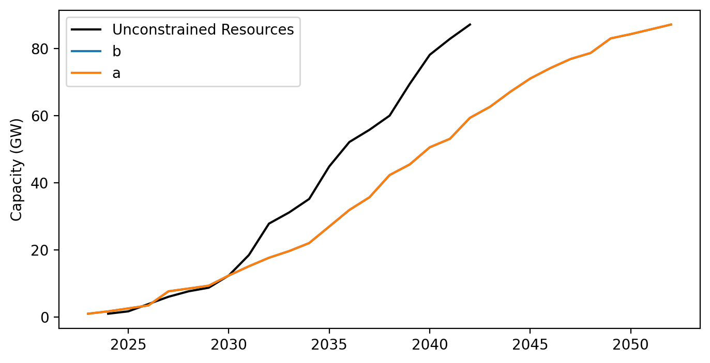
Cummulative Installed Capacity

